Slide 1
How are you feeling?

Slide 2
Other common utilities
grep
wc
ssh
|, >, >>, <, &&, ||

Slide 3
Finding help…
Often, `command --help`
Other times, `man command`
“Manual pages” -> “manpages” -> “man”
Of course:
Documentation
Stackoverflow
Reddit
Chatgpt
Google

Slide 4
Intro to Version Control
AI2C Tech Intro

Slide 5
Objectives
Discuss basic git concepts
Use basic git commands to manage a local repository
Use basic git commands to view a repository’s history and changes

Slide 6
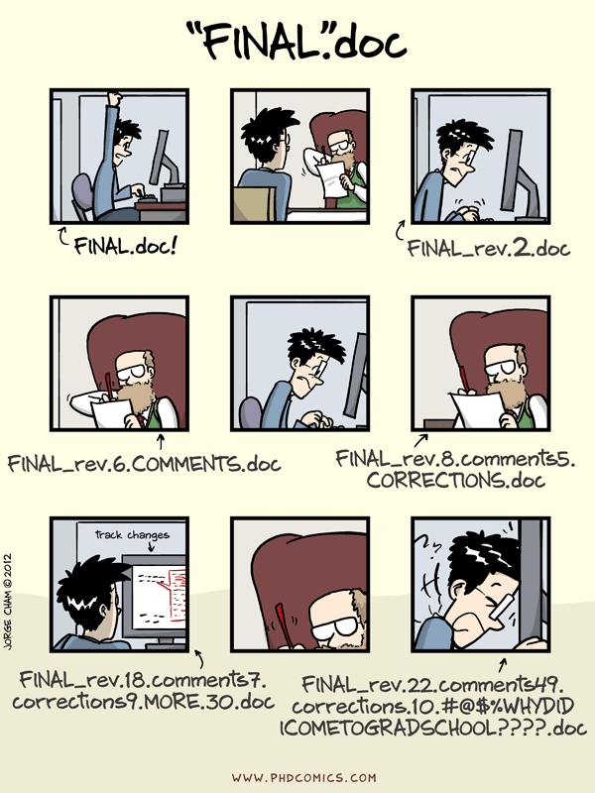
Version Control

Slide 7
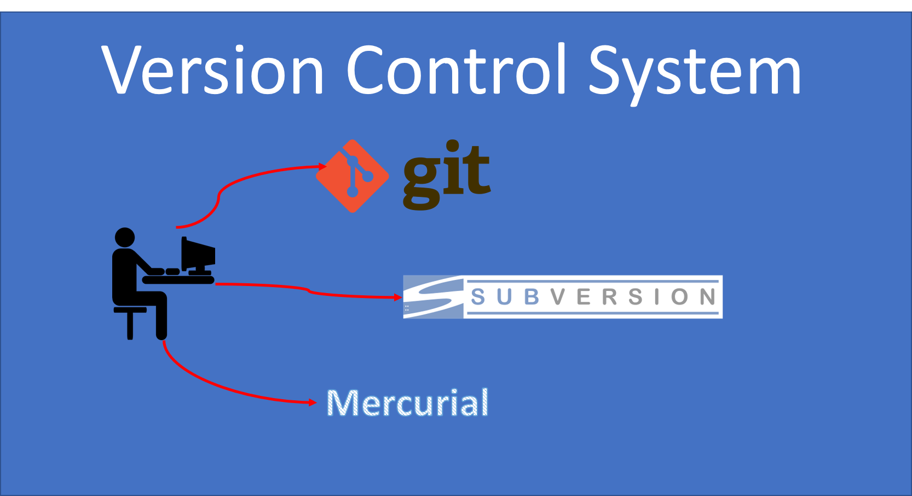
Common VCS
93% of developers use git¹
Notes:
¹ https://stackoverflow.blog/2023/01/09/beyond-git-the-other-version-control-systems-developers-use/

Slide 8

Git
Made by Linus Torvalds
Wrote the basics in about two weeks¹
The first commit was for git itself
Notes:
¹ https://marc.info/?l=git&m=117254154130732

Slide 9
Why Git?¹
Quoting Linus: "I'm an egotistical bastard, and I name all my projects after myself. First 'Linux', now 'Git'".
Alternatively, in Linus' own words as the inventor of Git: "git" can mean anything, depending on your mood:
Random three-letter combination that is pronounceable, and not actually used by any common UNIX command. The fact that it is a mispronunciation of "get" may or may not be relevant.
Stupid. Contemptible and despicable. Simple. Take your pick from the dictionary of slang.
"Global information tracker": you're in a good mood, and it actually works for you. Angels sing and light suddenly fills the room.
"Goddamn idiotic truckload of sh*t": when it breaks
Notes:
¹ https://archive.kernel.org/oldwiki/git.wiki.kernel.org/index.php/GitFaq.html#Why_the_.27Git.27_name.3F

Slide 10
Basic Ideas
Terminology¹
Process
Repository (today)
Clone (today)
Stage (today)
Commit (today)
Branch (later)
Merge (later)
Fetch (later)
Pull (later)
Push (later)
Initialize repository (or clone)
Make changes
Stage changes
Commit changes
???
Profit
Notes:
¹ https://www.w3schools.com/git/git_intro.asp?remote=github

Slide 11
Git Commit / Reset / Revert
Command | Description
git commit -m "message" | Commit staged changes with a message.
git commit -a -m "message" | Stage all modified (tracked) files and commit.
git commit --amend | Modify the last commit (message or content).
git reset HEAD~ | Undo the last commit but keep the changes unstaged.
git revert <commit> | Create a new commit that reverses a specific commit.

Slide 12
Hands-On #1
Initialize repository
Make some changes
Observe effects of changes
Stage changes
Commit changes

Slide 13
But why…
Most developer teams are not just one person
Having version control limits hassle across changes / teams
See how the code has changed over time
Analyze those changes for problem areas
(an aside) Not just for code…

Slide 14
Git History
I keep telling you that you can see what changed
So… how do we do that?
First we need to learn to read diffs…

Slide 15
Git Diff
Command | Description
git diff | Show unstaged changes.
git diff --cached | Show staged changes.
git diff HEAD | Compare working directory with last commit.
git diff <commit1> <commit2> | Compare two commits.
git diff <branch1> <branch2> | Show differences between two branches.
git diff <commit> <file> | Compare a file between commits.

Slide 16
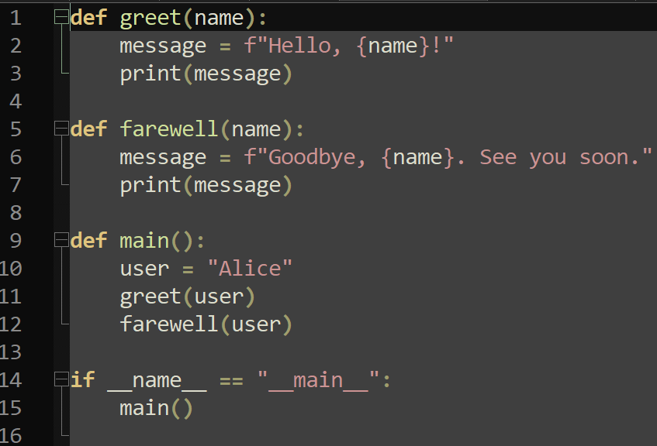
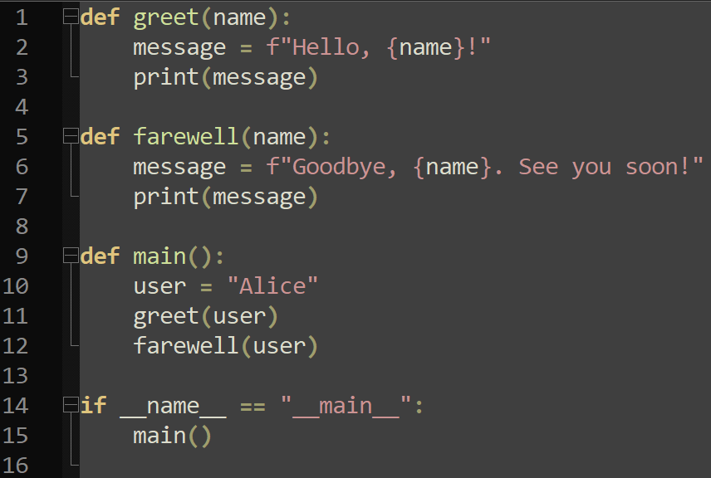
Spot the diff
Notes:
First, we need to be able to read diffs

Slide 17
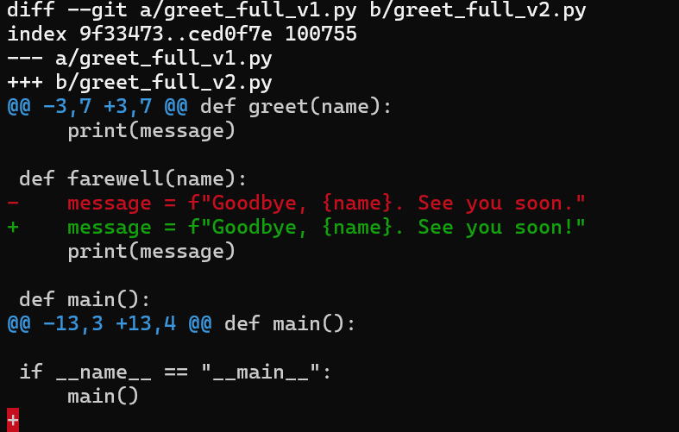
Spot the diff
Diffed two files
File metadata…
File “a” is denoted by ‘-’
File “b” is denoted by ‘+’
Notes:
```git diff greet_full_v1.py greet_full_v2.py```

Slide 18
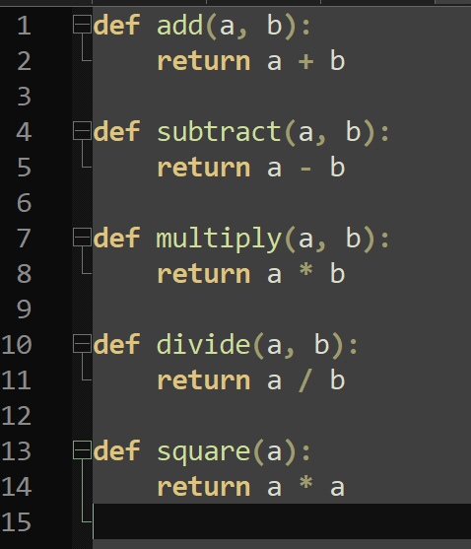
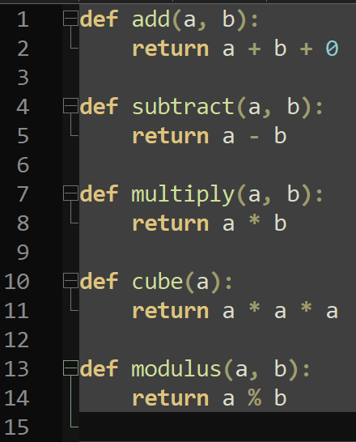
Spot the diff, again

Slide 19
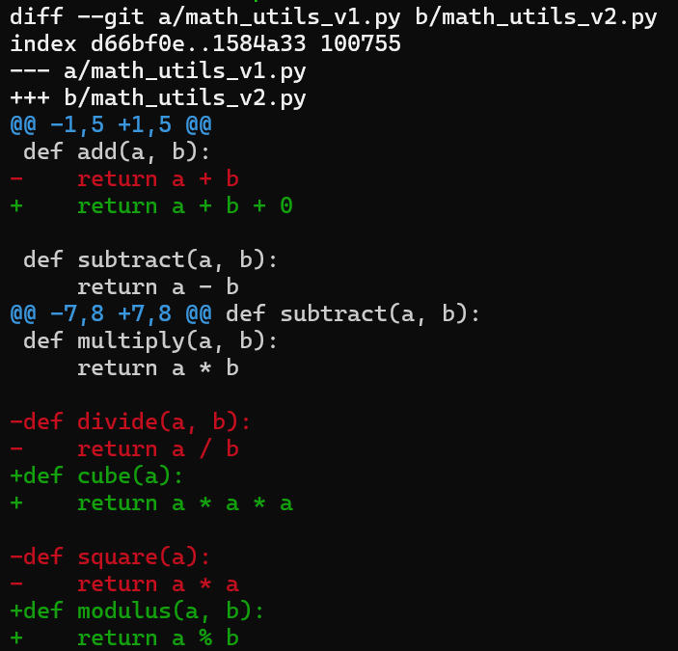
Spot the diff, again
Notes:
```git diff math_utils_v1.py math_utils_v2.py```

Slide 20
Git Log
Command | Description
git log | Show commit history.
git log --oneline | Condensed log (1 line per commit).
git log -p | Show log with diffs.
git log --stat | Show summary of changes per file.
git log --graph | Show commit history as a graph (great with branches).
git log <file> | Show commit history for a specific file.
git log -n <num> | Show the latest <num> commits.

Slide 21
Hands-On #2
Practice viewing file changes
Practice comparing commits

Slide 22
Why the command line???
Good practice using terminals
Not every UI exposes all the commands
Most servers are terminal-only
Using commands allows us to automate / script / chain
Reading documentation for command-line utilities is an art…

Slide 23
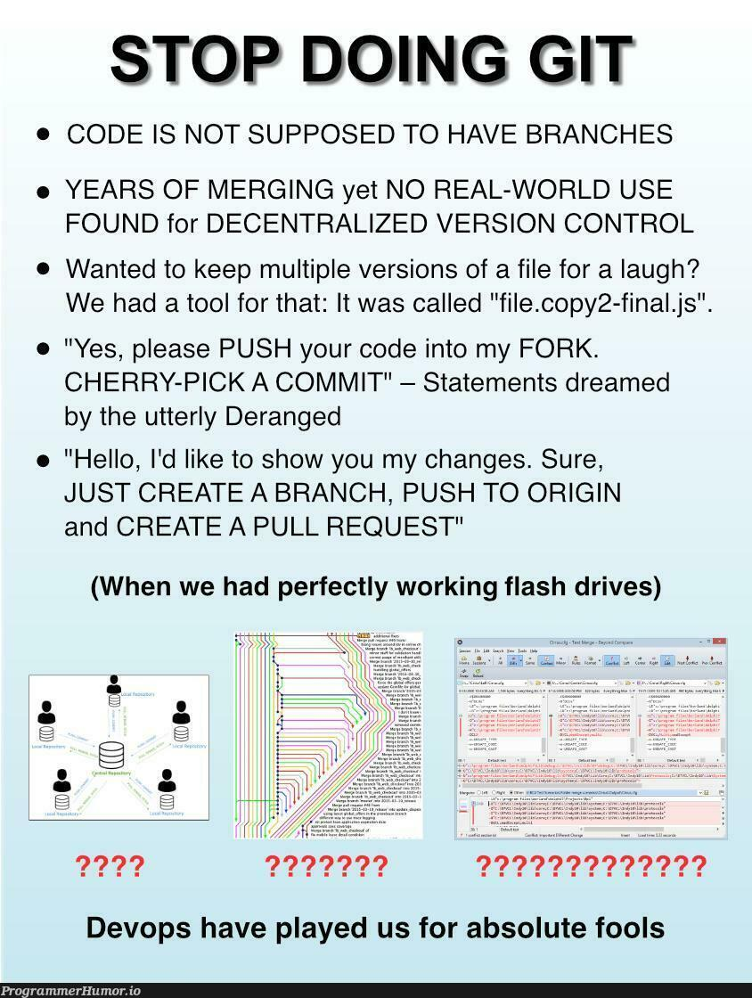
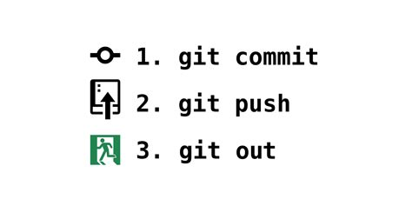
In Case of Fire…

Slide 24
Other Resources (HIGHLY RECOMMEND)
Oh My Git!
Learn Git Branching

Slide 25
Other useful commands
history – linux command history
grep – pattern matching utility

